Slide 1
Basic Electrical Technology [ELE 1051]
Chapter 3 - Single Phase AC Circuits
(3.1)

Slide 2
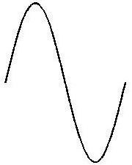
Introduction
Alternating Quantity
An alternating quantity is time dependent or frequency dependent.
The direction changes over every half cycle.
Eg: Time varying voltage, current etc.
i
i
i
0
0
t
0
t
t

Slide 3
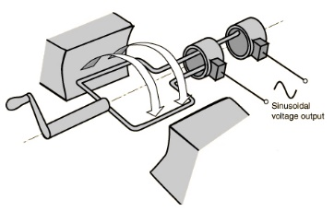


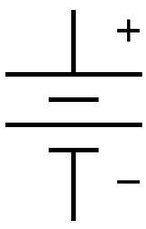
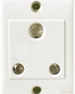

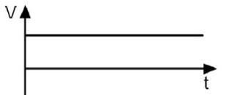
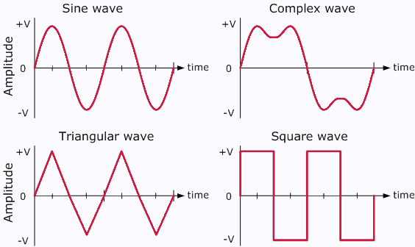
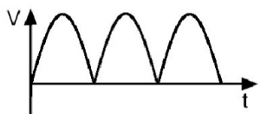
DC vs. AC
 | DC | AC
Obtained from | Battery / cell / derived from AC | AC Generator
Polarity | Positive and Negative | Oscillatory
P
N
Frequency | Zero | 50Hz or 60Hz
Types | Constant or pulsating | Sinusoidal, Trapezoidal, Triangular, Square

Slide 4
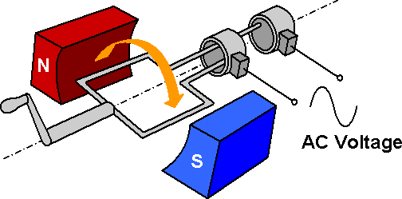
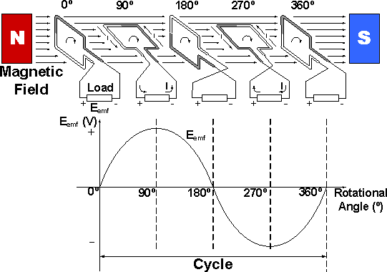
Generation of Alternating EMF
Generator working principle

Slide 5
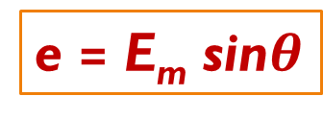
EMF Equation
EMF induced per conductor is
e = B l v sinθ
EMF Induced in one turn of a coil is
e = 2 B l v sinθ
If, b = width of the coil,
v = π b n ‘n’ is the speed in revolutions per sec.
e = 2 B l b π n sinθ
= 2 B A π n sinθ
If there are N turns in the coil, the emf induced is,
e = 2 π n B A N sinθ
b
l
Conductor
B
v
Turn of a coil
e = E_{m} sin$θ$

Slide 6
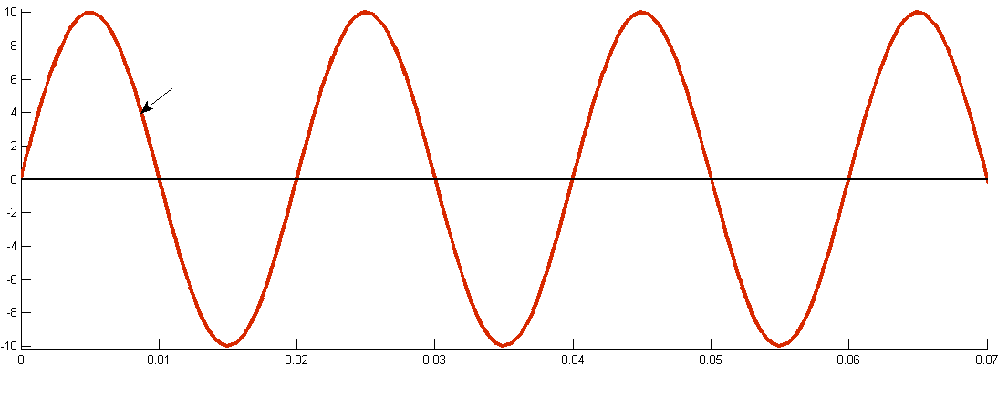




Terminologies in AC waveform
E_{m}
e(t) = E_{m}sin$ωt$
e(t) →
$$T=0.02s$$
$$f=50Hz$$
One Cycle
Time →
Cycle: Each repetition of the alternating quantity, recurring at equal intervals
Period (T): Duration of one cycle
Instantaneous Value (e(t)): The magnitude of a waveform at any instant in time
Peak Amplitude: Maximum value or peak value of alternating quantity
Frequency (f): Number of cycles in one second (Hz)
$$f=\frac{1}{T}$$

Slide 7




Average value of Sinusoidal Alternating Current
Definition: “The average value of an alternating quantity is defined as that value which is obtained by averaging all the instantaneous values over a period of half cycle”.
$$F_{avg}=\frac{1}{T}\int_{0}^{T}{f\left(t\right)dt}$$
For a periodic function f(t) with period T,
For sinusoidal signal,
i
$$I_{avg}=\frac{1}{T/2}\int_{0}^{T/2}{I_{m}sin⁡ωtdt}$$
I_{m}
$$i(t)=I_{m}sinωt$$
$$I_{avg}= \frac{{2I}_{m}}{π}$$
T
t

Slide 8
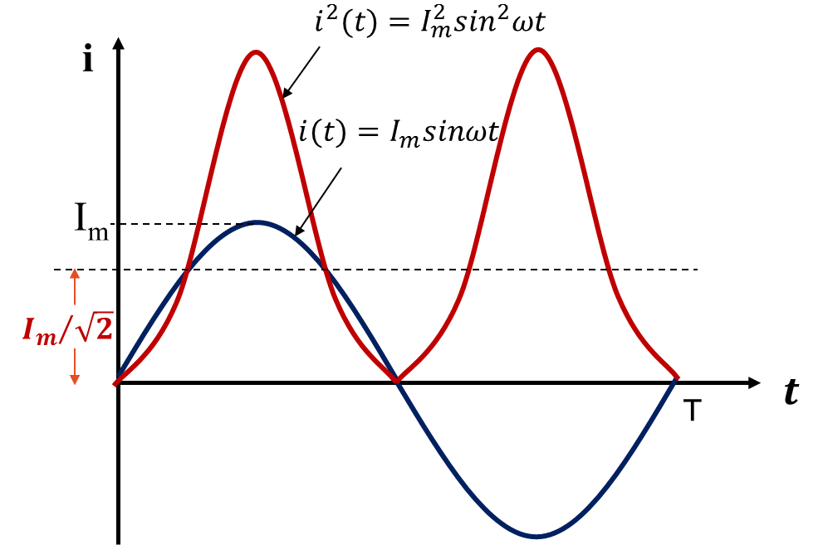



RMS value of Sinusoidal Alternating Current
Definition: “The RMS value is the square root of the mean (average) value of the squared function of the instantaneous values”.
$$F_{rms}=\sqrt{\frac{1}{T}\int_{0}^{T}{f^{2}\left(t\right)dt}}$$
For a periodic function f(t) with period T,
$$I_{rms}=\sqrt{\frac{1}{T}\int_{0}^{T}{I_{m}^{2}\sin^{2}ωt dt}}$$
$$I_{RMS}=\frac{I_{m}}{\sqrt{2}}$$
Notes:
W=2*pi*f=2*pi/T
T=2*pi/w
sin²wt=(1-cos2wt)/2

Slide 9


Form Factor & Peak Factor
$$Form Factor=\frac{RMS Value}{Average Value}=1.11 for sinusoidal$$
$Peak Factor= \frac{Maximum Value}{RMS Value}=\sqrt{2} for sinusoidal$
Notes:
Form factor importance:
Most of the the AC multimeters are designed to display the RMS value of a sinusoidal wave. Since RMS value can be difficult to calculate digitally, the average value is calculated and the result is multiplied by the form factor.
Peak factor importance:
to get an idea about the deviation of a waveform from d.c signal

Slide 10
Illustration 1
If an alternating voltage has the equation
v(t) = 155.56 sin 314t
Calculate:
Maximum voltage value
RMS value of the voltage
Frequency
The instantaneous voltage when t = 3ms
Notes:
Answers:
a) Maximum Value = 155.56 V
b) RMS Value = 110 V
c) Frequency = 50 Hz
d) Instantaneous voltage = 125.8V

Slide 11
Illustration 2
Determine the rms value, average value, and form factor of the current waveform
shown in Fig.
I avg = 2A
I rms = 2.3 A

Slide 12
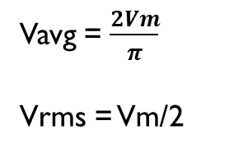
Illustration 3
For the circuit shown below, sketch the voltage across the resistance, & then find the Average value and RMS value of the same.
Vavg = $\frac{2Vm}{π}$
Vrms = Vm/2

Slide 13



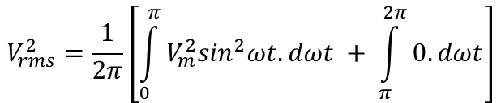

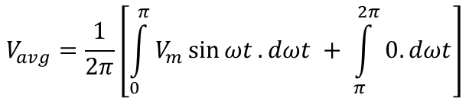
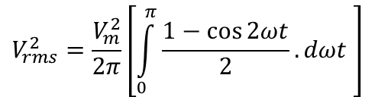





$$Solution:$$
$$Average Value$$
$$RMS Value$$
$$V_{avg}=\frac{1}{2π}\left[\int_{0}^{π}{V_{m}\sin{ωt}.dωt + \int_{π}^{2π}{0. dωt}}\right]$$
$$V_{rms}^{2}=\frac{1}{2π}\left[\int_{0}^{π}{V_{m}^{2}\sin^{2}ωt.dωt + \int_{π}^{2π}{0. dωt}}\right]$$
$$V_{avg}=\frac{V_{m}}{2π}{\left(−cos{ωt}\right)}_{0}^{π}$$
$$V_{rms}^{2}=\frac{V_{m}^{2}}{2π}\left[\int_{0}^{π}{\frac{1−\cos{2ωt}}{2}.dωt }\right]$$
$$V_{avg}=\frac{{−V}_{m}}{2π}(−1−1)$$
$$V_{rms}^{2}=\frac{V_{m}^{2}}{4π}\left[{ωt|}_{0}^{π}−{\sin{2ωt|}}_{0}^{π}\right]$$
$$V_{avg}=\frac{V_{m}}{π}$$
$$V_{rms}^{2}=\frac{V_{m}^{2}}{4π}\left[π\right]$$
$$V_{rms}=\frac{V_{m}}{2}$$

Slide 14

Thank You!

